Slide 1
ROLE OF SOCIAL MEDIA IN MARKETING
Student’s Name
Institution
Course Title
Assignment title
Date

Slide 2

INTRODUCTION
Have you ever thought how social media serves business communication and marketing purposes?
Some of the basic social media platforms used in marketing are Facebook and Instagram.
The company that I represent is Rideau Artisanal company and should use Facebook and Instagram to reach many clients (Sapkota et al., 2018).
Problem-our company rarely utilizes social media platforms in marketing.
Purpose statement-to gather reliable data on effectiveness of social media platforms in marketing.
Notes:
Have you ever thought how social media serves business communication and marketing purposes? Some of the basic social media platforms used in marketing are Facebook and Instagram. The company that I represent is Rideau Artisanal company and should use Facebook and Instagram to reach many clients. The problem in our company is that it rarely utilizes social media platforms in marketing.
Moreover, the purpose statement is to gather reliable data on effectiveness of social media platforms in marketing.

Slide 3
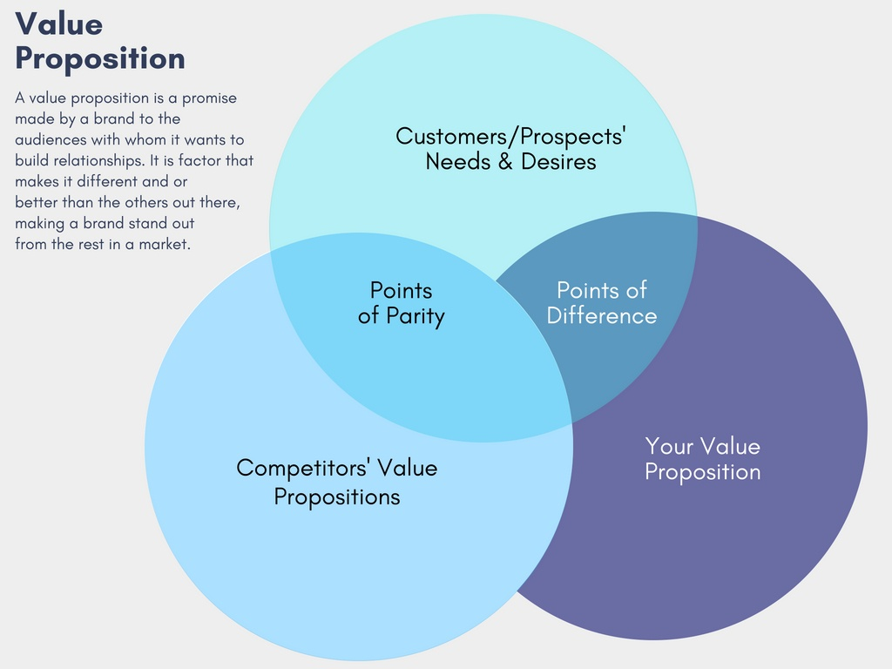
BACKGROUND INFORMATION
Rideau Artisanal company deals with citronella as well as standard candles.
The company operates in America and Canada.
The main competitors of the company are Achievers and Kudos company(Chen et al., 2020).
The aforementioned competitor companies have integrated use of social media platforms in marketing.
Despite the company being international, it has not maximized on sales (Sapkota et al., 2018).
Competitors value helps figure out the role of social media in marketing.
Notes:
The background information sections focuses on the Rideau Artisanal company and the key competitors. Rideau Artisanal company deals with citronella as well as standard candles. The company operates in America and Canada. The main competitors of the company are Achievers and Kudos company. The aforementioned competitor companies have integrated use of social media platforms in marketing. Despite the company being international, it has not maximized on sales. Competitors value helps figure out the role of social media in marketing.

Slide 4
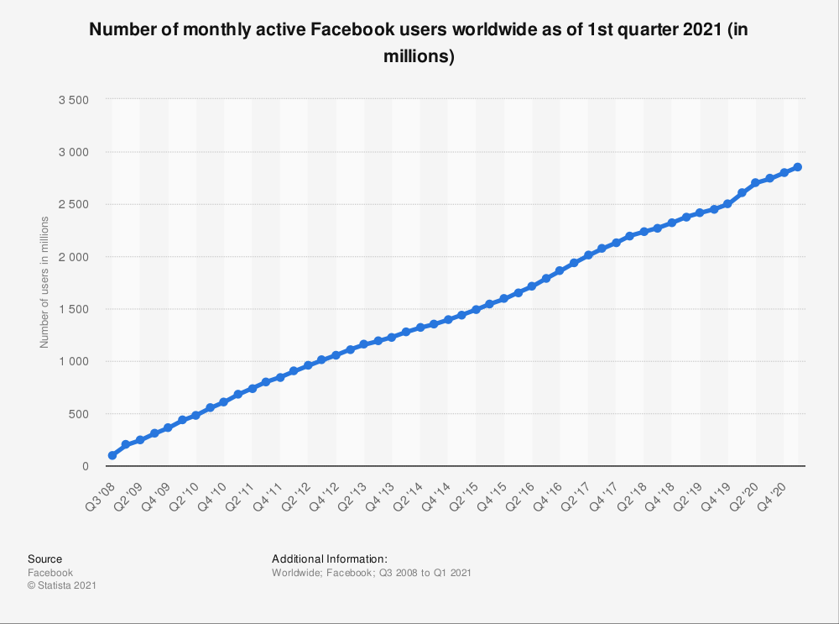
USE OF FACEBOOK IN MARKETING
Facebook has over 3 billion active users in a month.
60% of Achievers company customers are based online.
In every product they post on their timeline, 80% of their followers react by liking or commenting (Voorveld, 2019).
In ten product posts, companies acquire 5% new clients.
Facebook is effective since customers like, comment and make inquires even for a year old post.
Notes:
In the analysis of Facebook use in marketing, the most outstanding concept is the large number of users that are over 3 billion. 60% of Achievers company customers are based online. In every product they post on their timeline, 80% of their followers react by liking or commenting . In every product they post on their timeline, 80% of their followers react by liking or commenting. Facebook is effective since customers like, comment and make inquires even for a year old post.

Slide 5
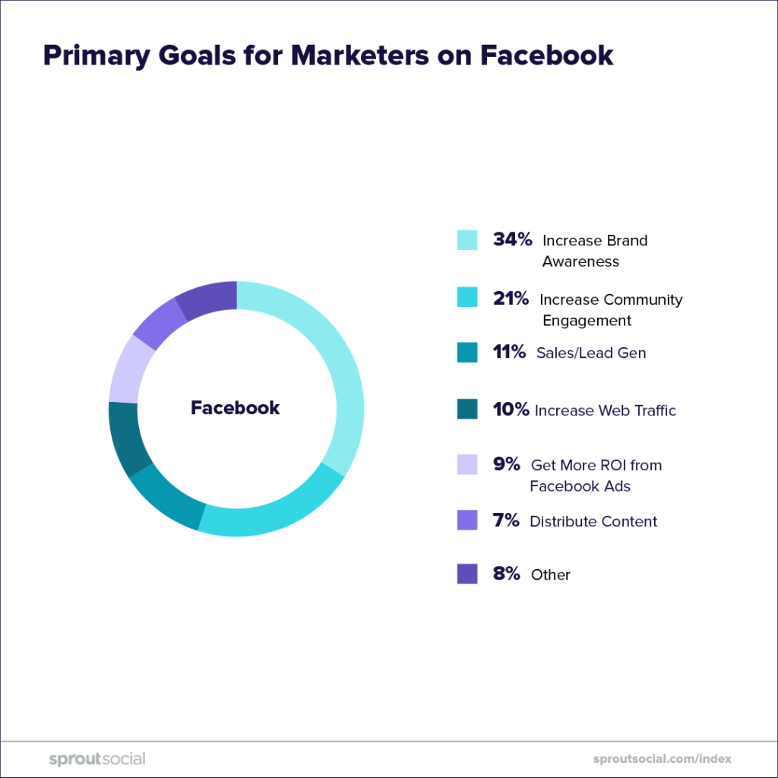
VISAUL REPRESENTATION OF PRIMARY GOALS FOR MARKETERS USING FACEBOOK.
Notes:
To get a better understanding of effectiveness of Facebook in business communication, a visual representation of the primary goals in the platform is crucial. The visual representation outlines that 34% increase bond awareness, 21% increase community engagement 11% for sales, 10% increase web traffic, 9% viewing various ads, 7% distribute content and others contribute to 8%. The above data indicates that companies have a variety of choices towards using social media.

Slide 6
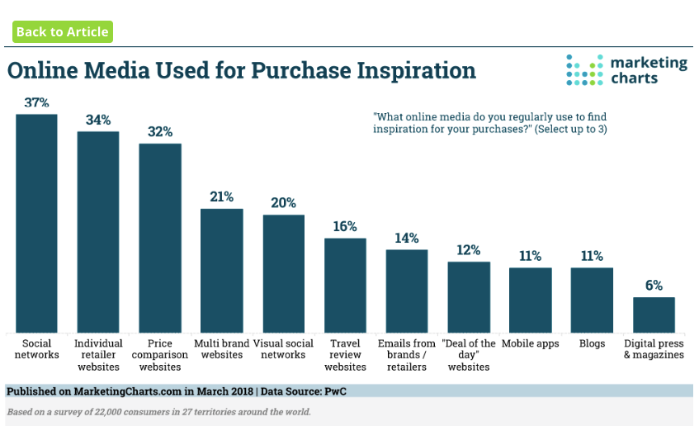
INSTAGRAM ANALYSIS
Just like Facebook, Instagram has played a crucial role in marketing.
37 % of companies that uses integrum target establishing social networks (Chen et al., 2020).
34% serve as retail platforms.
For the past one year, Kudos, the main competitors of our company has gained 40% follower increase.
Among the 40% the company has garnered 10% online market increase through their posts (Chen et al., 2020).
Notes:
Instagram analysis outlies that just like Facebook, Instagram has played a crucial role in marketing. 37 % of companies that uses integrum target establishing social networks. 34% serve as retail platforms. For the past one year, Kudos, the main competitors of our company has gained 40% follower increase. Among the 40% the company has garnered 10% online market increase through their posts.

Slide 7
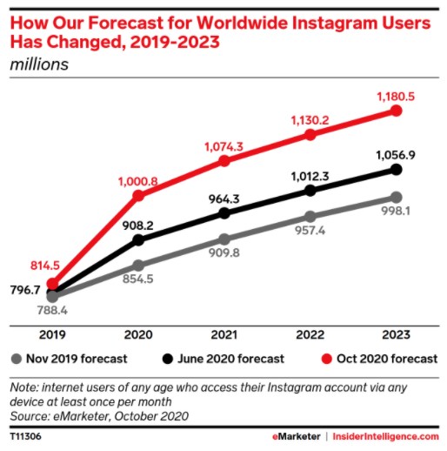
GRAPH OF INSTAGRAM USERS FORECAST
Notes:
To understand the future of social media in business communication for our company, it is important to focus on future prediction of Instagram users. The graph of Instagram users forecast covers five years starting from 2019-2023. The graph divides a year in three phases represented by June, October and November. According to the forecast graph, there is a gradual rise of Instagram users for next two years. However, October is seen to have the highest number of social media users and November has the lowest number.

Slide 8

RECOMMENDATIONS
As aforementioned, Facebook and Instagram plays critical roles in business communication purposes.
The company needs to create Facebook and Instagram page (Escobar-Rodríguez et al., 2017).
Posting regularly and responding to any inquires increases the followers and potential customers.
The company should embark on social media marketing strategy.
Integration of use of social media for business communication should be carried out gradually and analyzing the achievements annually.
Notes:
Recommendations are crucial for our company since they indicate the possible policies for the company to use social media in marketing as well as in business communication. As aforementioned, Facebook and Instagram plays critical roles in business communication purposes. The company needs to create Facebook and Instagram page. Posting regularly and responding to any inquires increases the followers and potential customers. The company should embark on social media marketing strategy. Integration of use of social media for business communication should be carried out gradually and analyzing the achievements annually.

Slide 9
CONCLUSION
Use of social media in business communication is an inevitable factor in the contemporary world.
Rideau Artisanal company has not effectively utilized social media platforms despite achievers and kudos utilizing social media.
Facebook and Instagram users are gradually increased and companies has benefited significantly.
To gather a wide customer base, the company needs to focus on social media marketing.
Marketing through social media is fast, reliable, and less costly.
Notes:
In conclusion, use of social media in business communication is an inevitable factor in the contemporary world. Rideau Artisanal company has not effectively utilized social media platforms despite achievers and kudos utilizing social media. Facebook and Instagram users are gradually increased and companies has benefited significantly. To gather a wide customer base, the company needs to focus on social media marketing. Marketing through social media is fast, reliable, and less costly.

Slide 10
REFERENCES
Chen, R. R., Davison, R. M., & Ou, C. X. (2020). A symbolic interactionism perspective of using social media for personal and business communication. International Journal of Information Management, 51, 102022.
Sapkota, K. N., & Vander Putten, J. (2018). Social media acceptance and usage by business communication faculty. Business and Professional Communication Quarterly, 81(3), 328-350.
Escobar-Rodríguez, T., & Bonsón-Fernández, R. (2017). Facebook practices for business communication among fashion retailers. Journal of Fashion Marketing and Management: An International Journal.
Voorveld, H. A. (2019). Brand communication in social media: A research agenda. Journal of Advertising, 48(1), 14-26.

